Slide 1

Smart Automated Car Parking System
Rahul Pinheiro 67
Manita Pasi 68
Chandni Patel 69
Date of presentation: 26-05-2021
Under the guidance of: Ms. Shree Jaswal
St. Francis Institute of Technology
Department of Information Technology

Slide 2

Content
Introduction
Review of literature
Problem definition & Proposed solution
Scope of project
System description
Hardware & software requirements
User Interface Design
Test cases
Result and discussions
Conclusion & Future Scope
Literature Cited
Acknowledgements

Slide 3
Introduction
Smart Parking is one of the most adopted and fastest growing Smart City Solutions across the world. The goal is to automate and decrease time spent manually searching for the optimal parking spot.
This system proposes a secure and efficient parking system which will work on sensor communication and secured wireless network with RFID reader.
In order to solve the problem of finding a vacant parking space in particular area, the navigation system in the parking area is created.
The user can book a parking slot according to their convenience in advance and accordingly will be guided to the parking area.
Using this system, we can easily find vacant space for parking and parking waiting time is reduced efficiently.

Slide 4
Review of literature
Observation and analysis of literature survey
Ref No: | Parameters Considered | Algorithms | Limitations/Suggestions
[1] A. Chatterjee, S. Manna, A. Rahaman, A. R. Sarkar, A. Ghosh and A. A. Ansari, ”An Automated RFID Based Car Parking System”,2019. | RFID Reader | RFID tagging | With the help of RFID in the system, vehicle identification time is reduced to a great extent. It avoids the traffic jam problem near the gates of parking lots

Slide 5
[2] Y. Chang and T. K. Shih, ”RFID-Based intelligent parking management system with indoor positioning and dynamic tracking,” 2017 | Finding and allocating a parking space | Dynamic tracking algorithm | While entering and leaving the parking lot, they can use dynamic tracking to find their car parking space and exit. It can also save more waste time
[3] O. Orrie, B. Silva and G. P. Hancke, ”A wireless smart parking system,”2015 | Addition of security features | Privacy and security | The correct security features will help to reduce the amount of time taken to find a parking spot in busy areas and help in the identification of the vehicle.

Slide 6
[4] Prof.Gayatri Bhandari,Mrinal Bari, Shweta Borse, Ashwini Gaikwad, Reshma Kadam, ” Parking Navigation For Multiple Parking System”,2014 | Navigation system in mobile application. | Central server and sensor communication | Vacant space for parking can be easily viewed to the driver using the mobile application.
[5] ElakyaR, Juhi Seth, Pola Ashritha, R Namith, ”Smart Parking System using IoT”,2019 | Real time information | Real time process and information of the parking slots | Resolve the growing problem of traffic congestion.

Slide 7
Review of literature
Gap identified
Addition of security features to protect the users’ privacy is vital.
The parking guidance system can be more correct and efficient.
The challenge in obtaining the information about the detection of vehicles depends on the underlying infrastructure in the place where the system is going to be implemented, or on the technology that was chosen to be used according to the system to be implemented.
With IOT, There are several opportunities for failure with complex systems. There is a chance that the software can be hacked and your personal information misused.

Slide 8
Problem definition & Proposed solution
Problem Definition: To develop an automated car parking system with RFID reader to minimize waiting time and compute the shortest path to the parking area..
Proposed Solution: The project aims at bridging the gap by providing an application for users to guide them a smooth hassle-free parking experience that can be deployed for use in diverse premises. The primary purpose of this research work is to provide recommendations to improve parking at various premises. To address future needs as well as to improve the utilization and efficiency of existing parking, parking alternatives were considered for future scope.

Slide 9
Scope of project
The system handles operations like searching for parking spaces, booking the parking slots and payment.
Alert message is displayed to the user to remind him at the end of his time slot.
RFID cards for payment and verification purposes are included in the system.
During registration, the user will be given a unique number that will be used for allotment of RFID cards.
All the user details are stored in a database and can only be accessed by the admin.
User Interface is made user friendly and appealing.

Slide 10
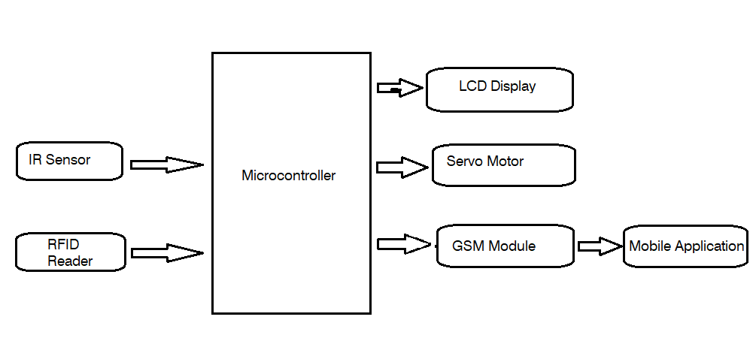
System description
To reduce the loss we propose a system which will include a RFID Payment system which consists of RFID, motor where the user has to tap the RFID and the gate will be opened with the help of motor and then with the help of android mobile application users can search the parking, check for available slots and book a parking slot which was developed with the help of Android studio and while exiting the RFID reader which will be scanned and the amount will be deducted from the card scanned. Performance Will Be Evaluated Based On the values of accuracy, error rate, recall, speciﬁcity, precision, etc.
Fig 1: Hardware Block Diagram

Slide 11
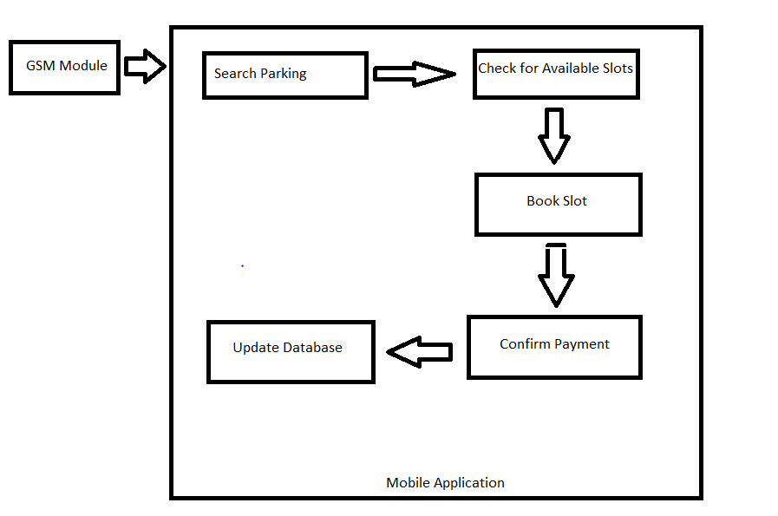
System description
Fig 2: Software Block Diagram

Slide 12
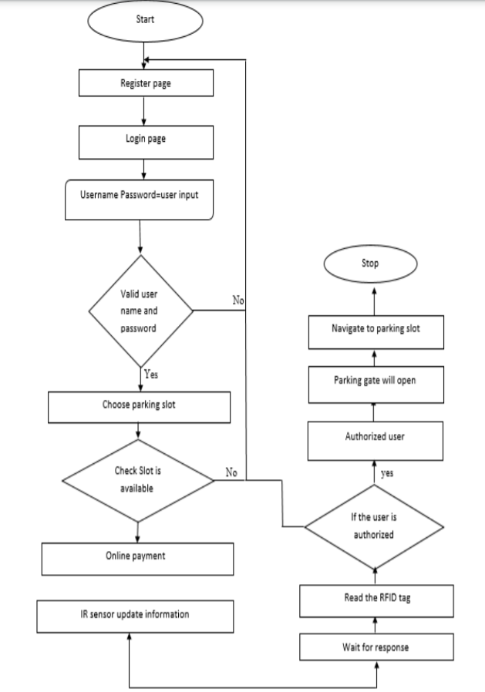
Fig 3: System Flowchart

Slide 13
Hardware & software requirements
Hardware Requirements:
• Raspberry Pi
• Servo Motors
• RFID Reader
• L293D Motor Driver Module
Software Requirements:
• Google API
• Android Studio
• IDLE Python

Slide 14
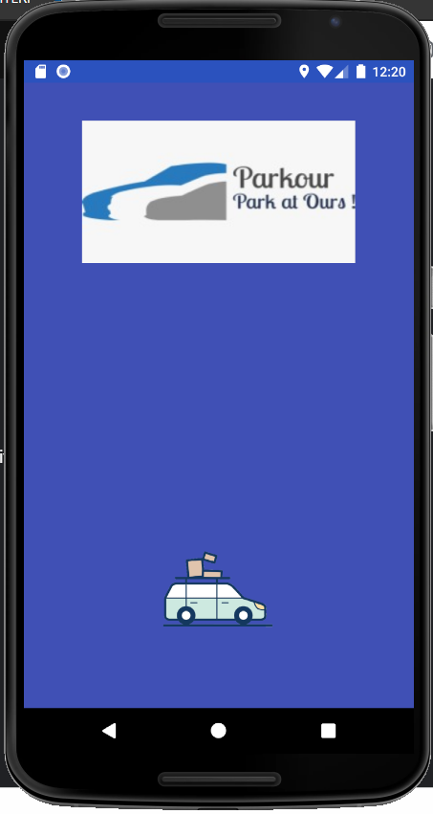
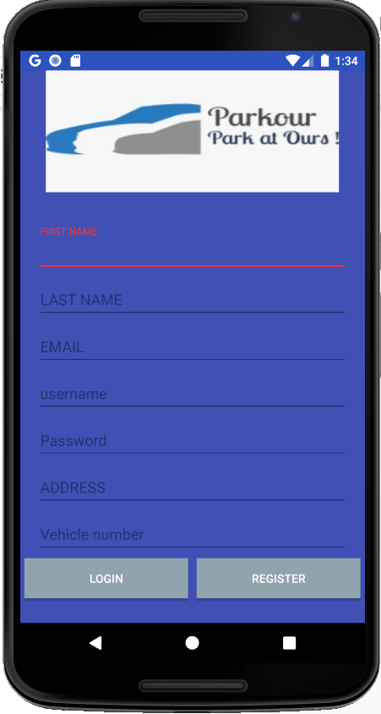
User Interface Design
Fig. 1: Welcome Page Fig.2: Register/Login Page

Slide 15
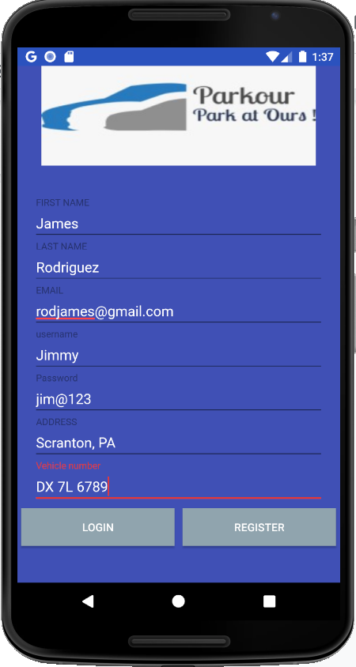
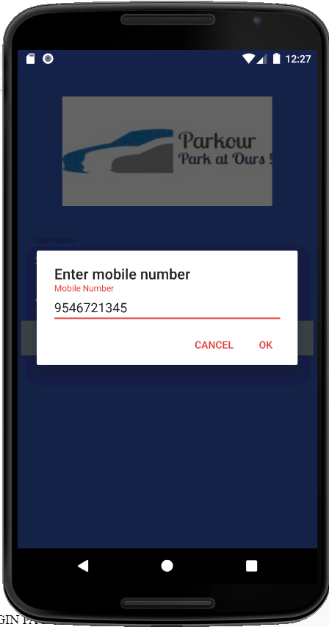
Fig. 3: Register new User Fig.4: OTP prompt

Slide 16
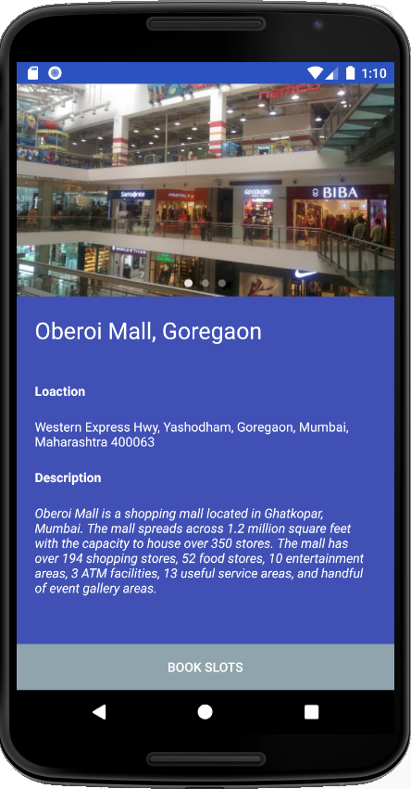
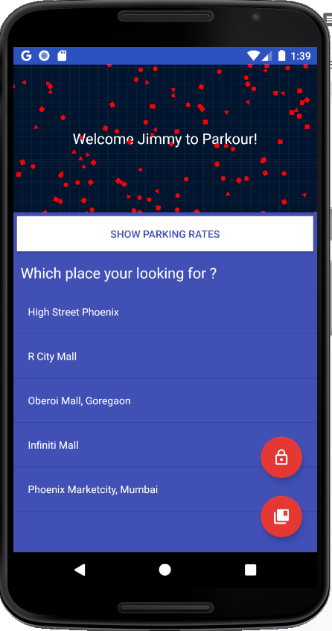
Fig. 5: Information Page Fig. 6: Home Page

Slide 17
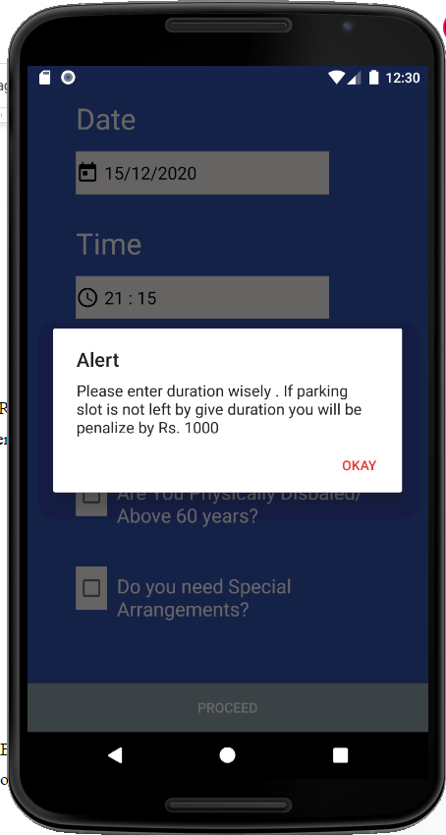
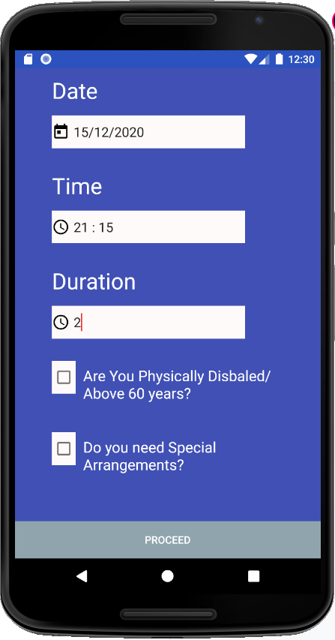
Fig. 7: Alert Message Fig. 8: Date and Time Booking

Slide 18
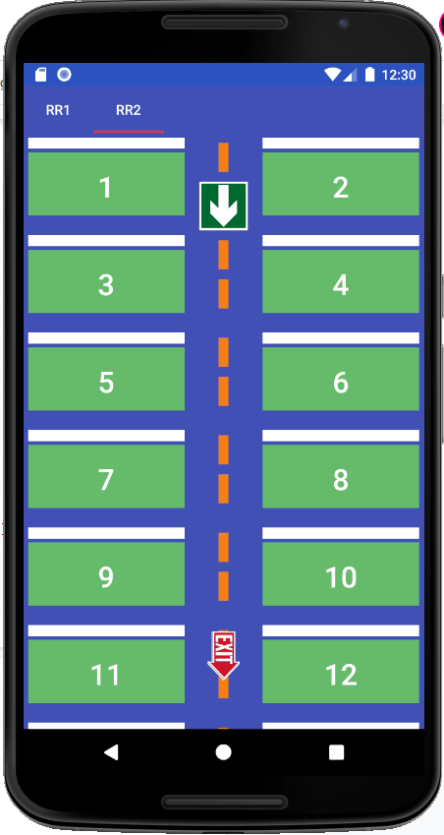
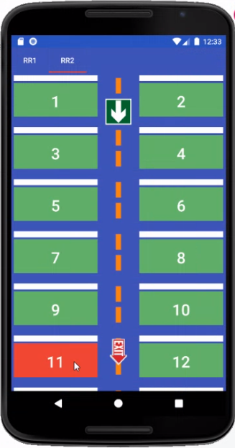
Fig.9: Slot Booking Page Fig.10: Slot Confirm

Slide 19
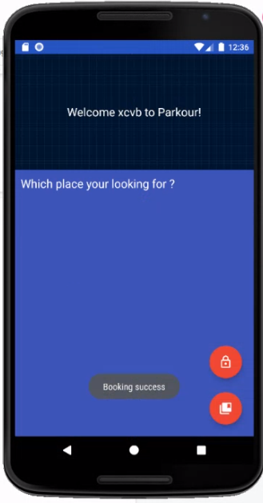
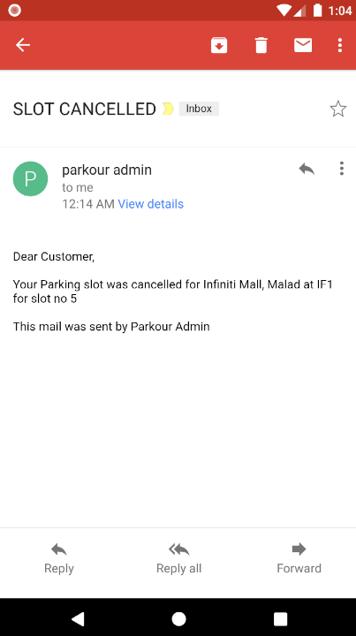
Fig.11: Booking Confirmation Fig.12: Slot cancelled confirmation

Slide 20
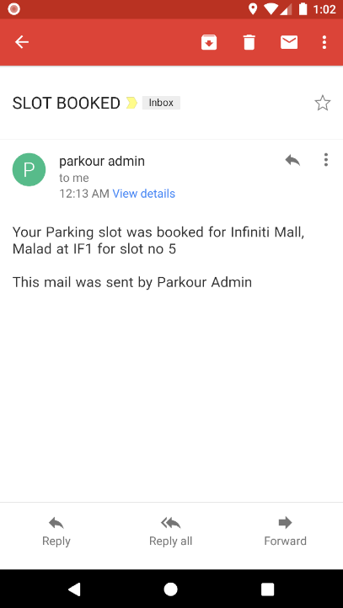
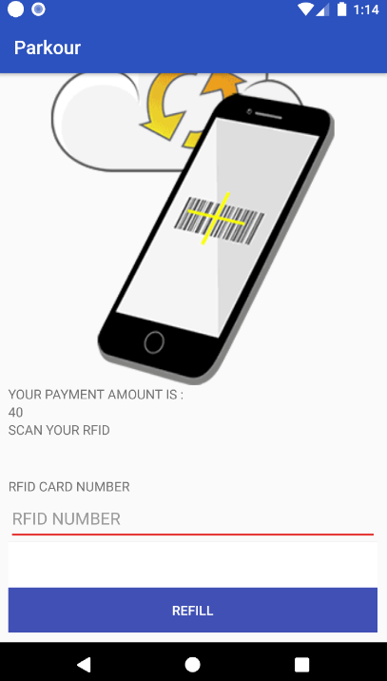
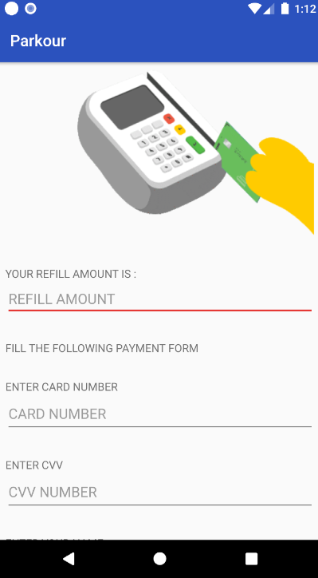
Fig.13: Slot booked confirmation Fig.14: RFID Scan and Pay
Fig.15: RFID refill

Slide 21
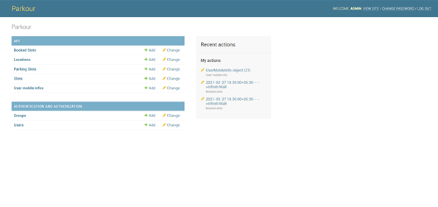
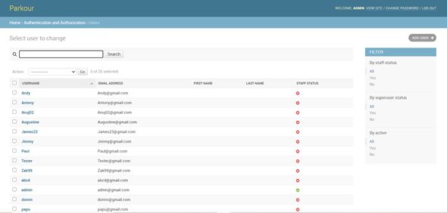
Fig.16: Admin Page

Slide 22
Test Cases
Test Case_Id | Test Name | Input | Expected output | Actual output | Pass/Fail | Comment
1 | Login Page | Username and Password | Successfully redirecting to welcome/home page | Successfully redirecting to welcome/home page. | Pass | Only if username and password are correct
2 | Sign Up Page | Username email-id, mobile no,vehicle no | Successfully registering a new user if account does not exists | Successfully registering a new user if account does not exists | Pass | Only if details are correct and if it is a new user account
3 | Date and time booking page | Date, time and duration | Successfully redirecting to slot booking page | Successfully redirecting to slot booking page | Pass | Only if date,time and duration are correct
4 | Admin Page | Enter Password, Re-enter Password | User Registered Successfully | User Registered Successfully | Pass | Only if both the passwords are same

Slide 23
Result and Discussions
In the smart automated car parking system application the server side and the user side application were successfully implemented.
The android application is developed which can seamlessly guide users from one source to the destination. We have developed different pages such as signup/login page, home page, information page which displays information about that particular mall, booking page where user can check the slot availability and book the available slot, booking dashboard which shows the user booking details, payment page where with the help of RFID cashless payment is done, for this we have integrated hardware and used iot concept.
There is also an admin where the admin can book, cancel the slots and manage it.
During the whole process, user satisfaction is of utmost importance. The user should be able to search, locate and navigate to the specified location hassle free

Slide 24
Conclusion & Future Scope
This system is an added value to urban life. The system benefits of smart parking go well beyond avoiding the needless circling around the blocks.
Through this system the users can do the parking on their own with the help of mobile application rather than guiding them manually. Thus, this simple concept when implemented will create a great impact in everyday life.
For future purposes we can add a navigation system to our project where the users can be navigated to their booked parking slot and along with that we can increase our security to a higher level by providing OTP while payment , along with that we can improve our UI by adding some extra features to it such as transitions, animations, hover effect and so on.

Slide 25
Literature Cited
[1] A. Chatterjee, S. Manna, A. Rahaman, A. R. Sarkar, A. Ghosh and A. A. Ansari, ”An Automated RFID Based Car Parking System,” 2019 Inter- national Conference on Opto-Electronics and Applied Optics (Optronix), Kolkata, India, 2019, pp. 1-3.
[2] Y. Chang and T. K. Shih, ”RFID-Based intelligent parking management system with indoor positioning and dynamic tracking,” 2017 10th Interna- tional Conference on Ubi-media Computing and Workshops (Ubi-Media), Pattaya, 2017, pp. 1-8.
[3] O. Orrie, B. Silva and G. P. Hancke, ”A wireless smart parking system,” IECON 2015 - 41st Annual Conference of the IEEE Industrial Electronics Society, Yokohama, 2015, pp. 004110-004114.
[4] Prof.Gayatri Bhandari,Mrinal Bari, Shweta Borse, Ashwini Gaikwad, Reshma Kadam, ” Parking Navigation For Multiple Parking System”, International Journal of Advanced Research in Computer Engineering and Technology (IJARCET) Volume 3 Issue 9,September 2014
[5] ElakyaR, Juhi Seth, Pola Ashritha, R Namith, ”Smart Parking System using IoT”, International Journal of Engineering and Advanced Technol- ogy (IJEAT) ISSN: 2249 – 8958, Volume-9 Issue-1, October 2019

Slide 26
Acknowledgements
We would like to thank Ms. Shree Jaswal for the guidance, inspiration and constructive suggestions that helped us in the preparation of this project. We also thank our colleagues who have helped in successful completion of the project. The satisfaction that accompanies the successful completion of any task would be incomplete without the mention of these people.

Slide 27
Questions??
Thank You!

